Slide 1
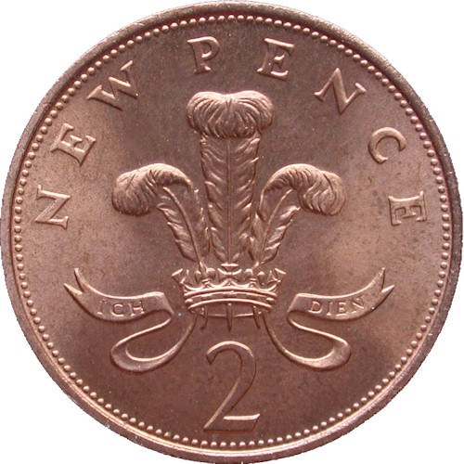
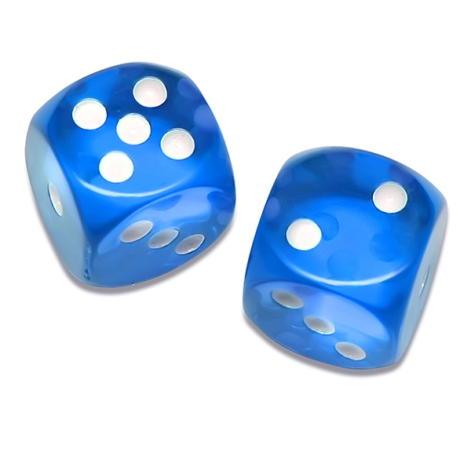
For today’s lecture you will need:
x 1
x 1
Notes:
Tell class to come and collect their dice and coin before lecture begins. Also pass out the sheet for them to fill out their estimated height (anonymously). Additionally set up lecture room PC for R plots (ready for mid lecture exercise).

Slide 2

SOEE1475 Statistics and Data Analysis
Lecture 1: Probability
Graeme T. Lloyd
Notes:
“Never tell me the odds”!
(Today’s lecture will be about probability as this is a key concept in statistics – i.e., how surprised should we be by natural phenomena we ecnounter.

Slide 3

Lesson #1
Notes:
Before we begin I am going to teach you the two most important lessons in stats/data analysis.

Slide 4
Lesson #1
x | y
10 | 9.14
8 | 8.14
13 | 8.74
9 | 8.77
11 | 9.26
14 | 8.10
6 | 6.13
4 | 3.10
12 | 9.13
7 | 7.26
5 | 4.74
Notes:
Here are some data, x and y.

Slide 5
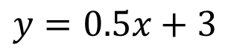
Lesson #1
x | y
10 | 9.14
8 | 8.14
13 | 8.74
9 | 8.77
11 | 9.26
14 | 8.10
6 | 6.13
4 | 3.10
12 | 9.13
7 | 7.26
5 | 4.74
Model A
$$y=0.5x+3$$
Notes:
Here is a model (expressed as an equation) that attempts to describe the relationship between x and y.

Slide 6
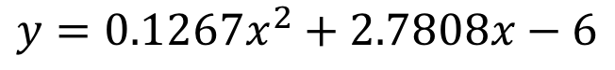
Lesson #1
x | y
10 | 9.14
8 | 8.14
13 | 8.74
9 | 8.77
11 | 9.26
14 | 8.10
6 | 6.13
4 | 3.10
12 | 9.13
7 | 7.26
5 | 4.74
Model A
$$y=0.5x+3$$
Model B
$$y={0.1267x}^{2}+2.7808x−6$$
Notes:
Here is an alternative, more complex model that also attempts to describe the relationship between x and y. Which model does the best job? (Ask class – get greeted with blank stares)

Slide 7
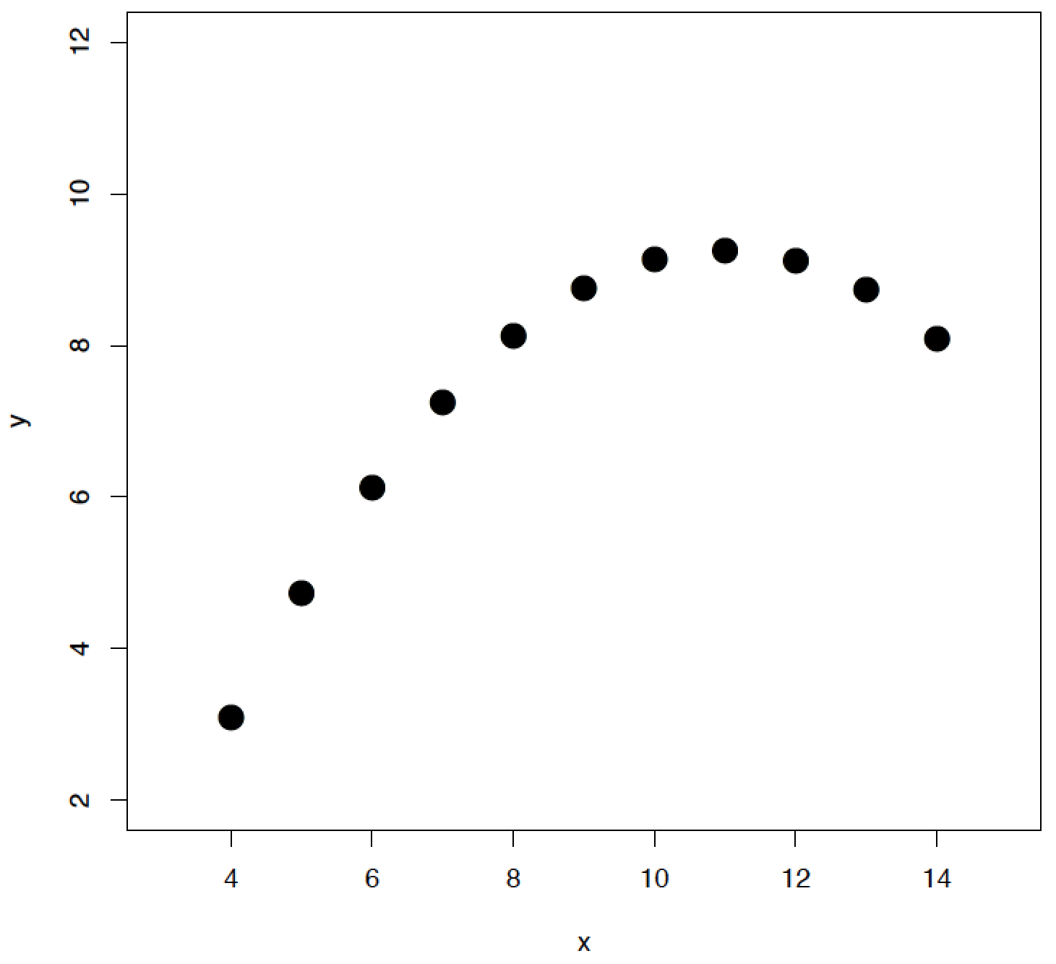
Lesson #1
Notes:
Let’s rephrase the question. Here are some data, x and y.

Slide 8
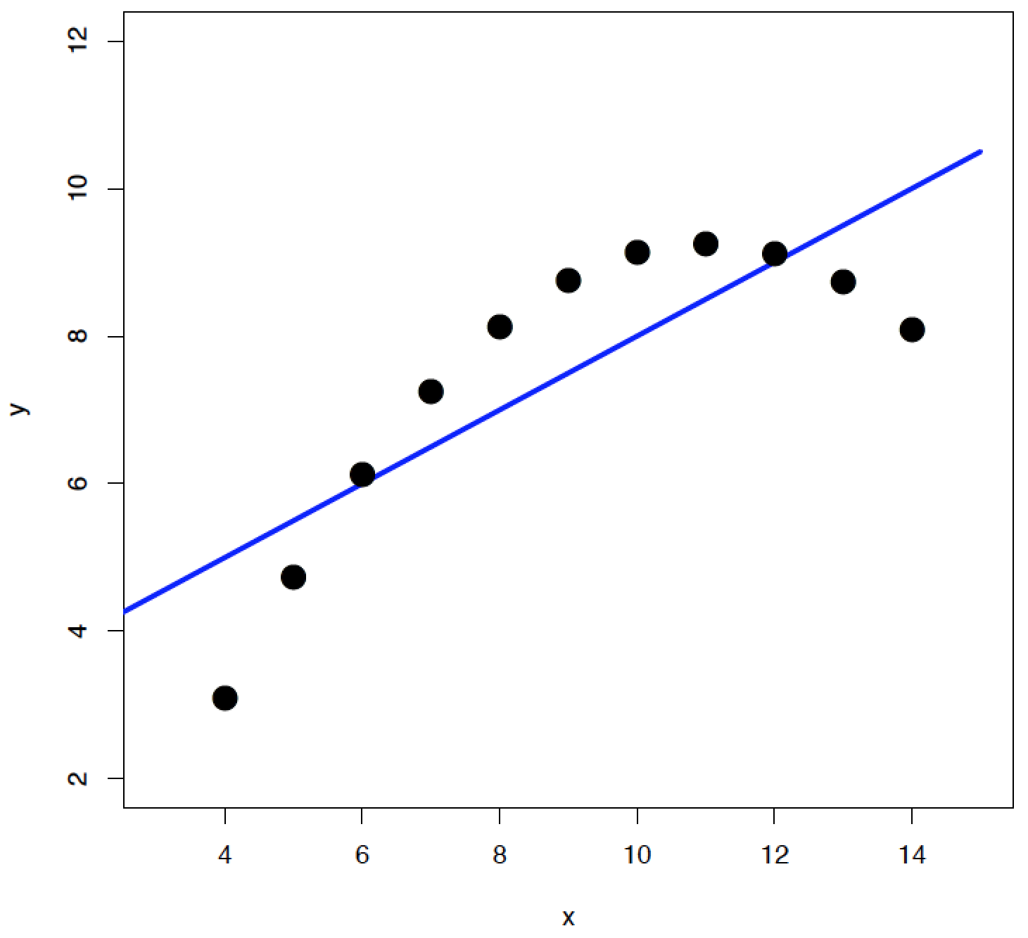
Lesson #1
Model A
Notes:
Here is a model, expressed in the form of a line, that attempts to explain the relationship between x and y.

Slide 9
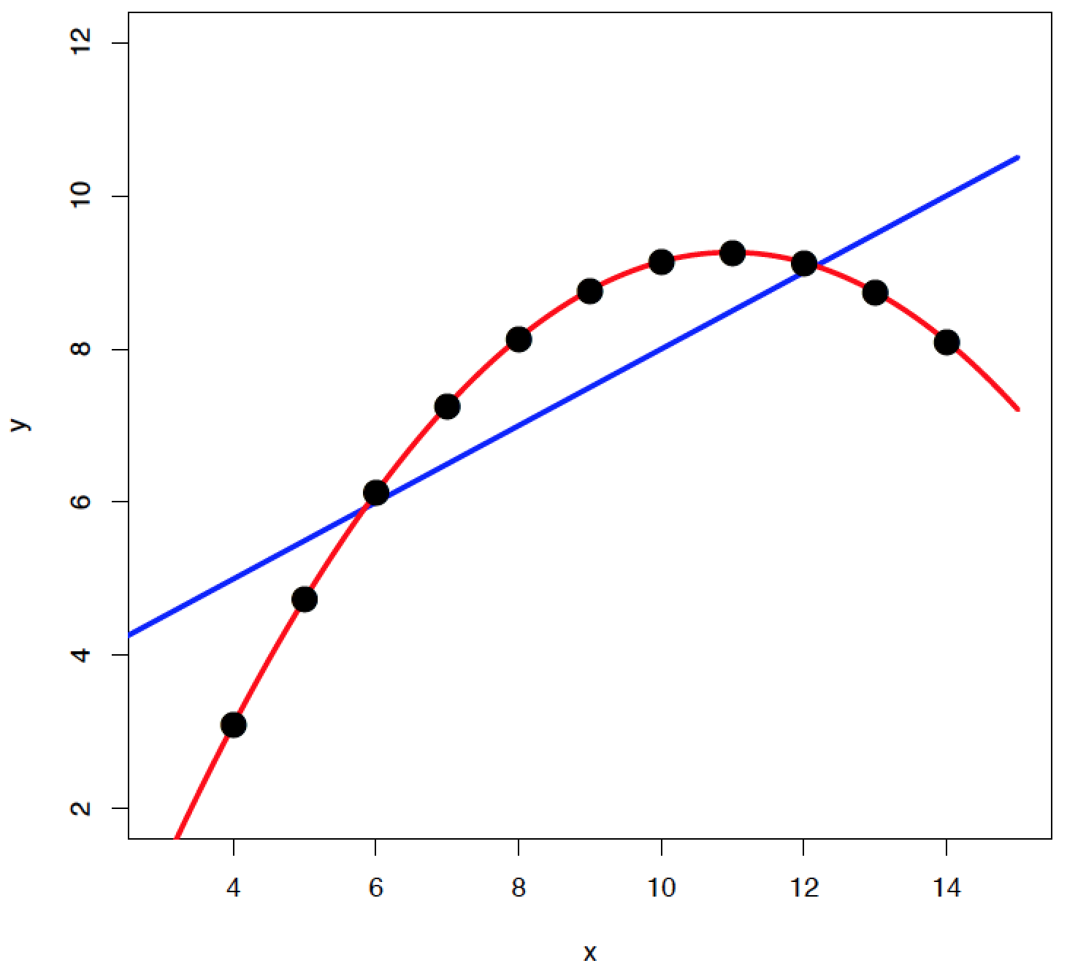
Lesson #1
Model A
Model B
Notes:
Here is an alternative, more complex (i.e., curved) line that attempts to explain the relationship between x and y.
Which does the best job? See how much easier it is now?

Slide 10
Lesson #1
Always plot your data
Notes:
Lesson #1 then, is always plot your data!

Slide 11
Lesson #2
Notes:
Second lesson:

Slide 12
Lesson #2
x | y
10 | 7.46
8 | 6.77
13 | 12.74
9 | 7.11
11 | 7.81
14 | 8.84
6 | 6.08
4 | 5.39
12 | 8.15
7 | 6.42
5 | 5.73
Notes:
Here and some different data (x and y).

Slide 13
Lesson #2
x | y
10 | 7.46
8 | 6.77
13 | 12.74
9 | 7.11
11 | 7.81
14 | 8.84
6 | 6.08
4 | 5.39
12 | 8.15
7 | 6.42
5 | 5.73
Model
$$y=0.5x+3$$
Notes:
Here is a model that attempts to describe the relationship between x and y.

Slide 14
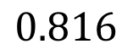
Lesson #2
x | y
10 | 7.46
8 | 6.77
13 | 12.74
9 | 7.11
11 | 7.81
14 | 8.84
6 | 6.08
4 | 5.39
12 | 8.15
7 | 6.42
5 | 5.73
Model
$$y=0.5x+3$$
“Goodness”
$$0.816$$
Notes:
Here is a numerical estimate of how good a job that model does. (0 is worst, 1 is best, so this seems good.)

Slide 15
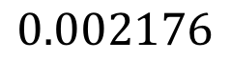
Lesson #2
x | y
10 | 7.46
8 | 6.77
13 | 12.74
9 | 7.11
11 | 7.81
14 | 8.84
6 | 6.08
4 | 5.39
12 | 8.15
7 | 6.42
5 | 5.73
Model
$$y=0.5x+3$$
“Goodness”
$$0.816$$
“Chanceness”
$$0.002176$$
Notes:
Here is the probability that the pattern is due to chance alone (0 is best, 1 is worst, again we seem to have a good value.)
But, is our model really doing a good job?

Slide 16
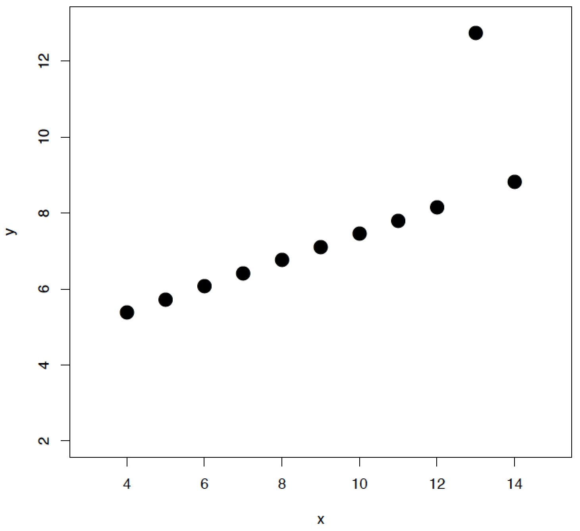
Lesson #2
Notes:
Let’s apply Lesson #1. Does anything look weird?
Yes! We want to know what that one screwy point is all about.

Slide 17
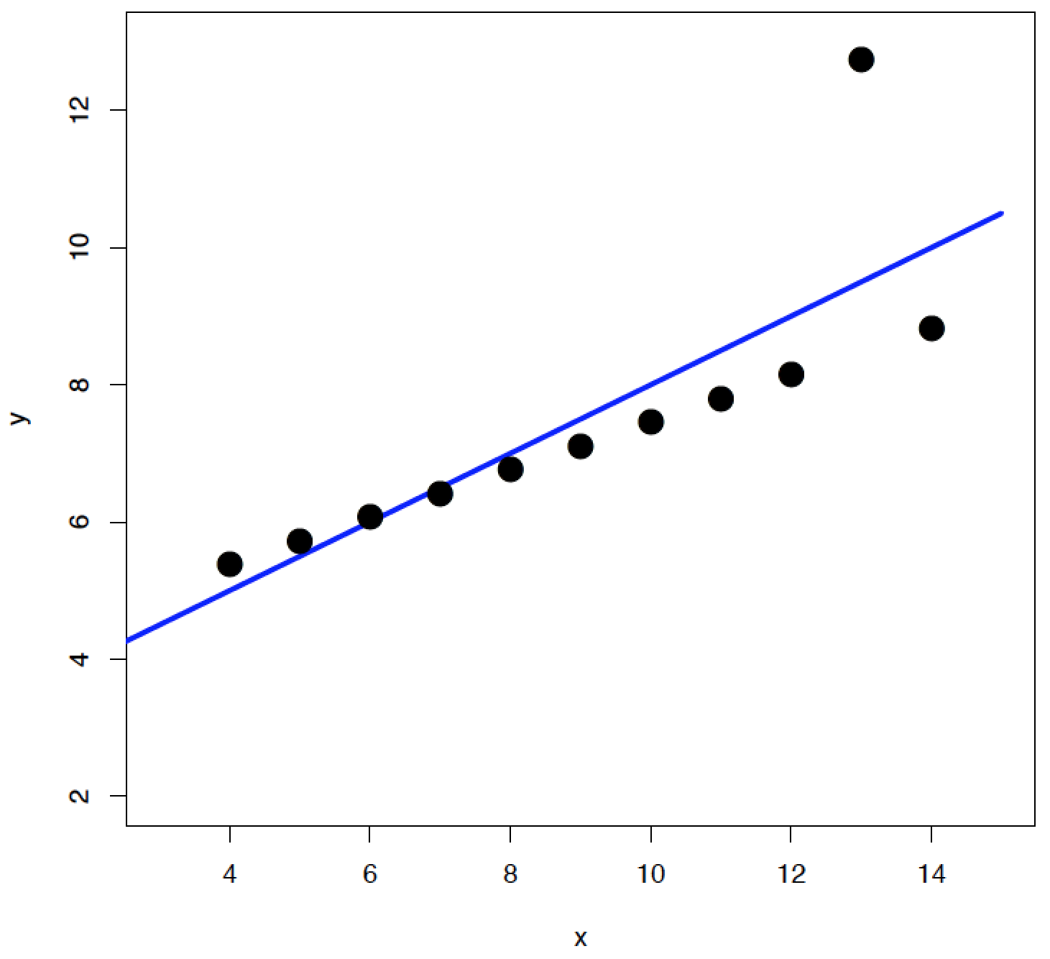
Lesson #2
Model
Notes:
Here is our model. Would we prefer a different line if we decide that one point is different?

Slide 18
Lesson #2
Statistics isn’t a substitute for
thinking about your data
Notes:
Lesson #2 is always think about your data – do not rely on summary values.

Slide 19
Today
Introduction to probability
Probability distributions
The binomial, uniform, and normal distributions
Notes:
Today’s topics.

Slide 20
Probability: nomenclature
Notes:
To discuss probability we should begin by introducing the correct nomenclature.

Slide 21
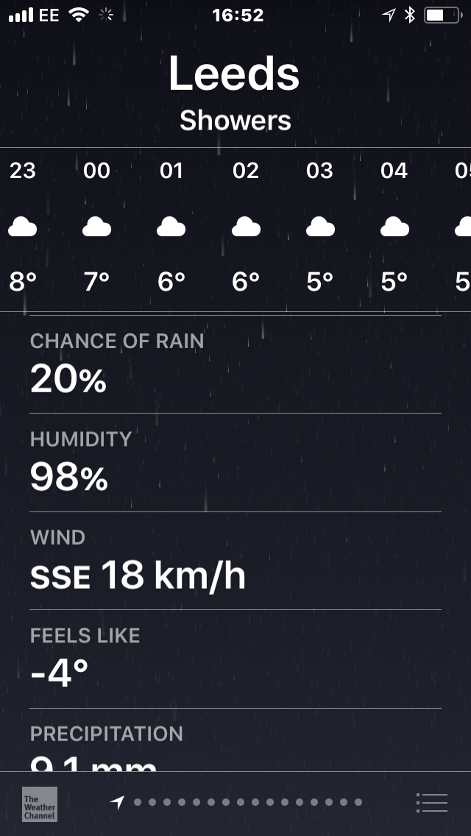
Probability: nomenclature
Notes:
Here is an example of probability in everyday life – the chance of rain. Note that this is expressed as a percentage.

Slide 22
Probability: nomenclature
p(Rain) = 0.2
Notes:
More formally we could state it like this. Probability of rain – 0.2. Note that a p-value is 1/100th of a chance expressed as a percentage

Slide 23
Probability: rules
Notes:
Unlike percentages probabilities have certain specific rules that we must apply to use them correctly.

Slide 24
Probability: rules
0 ≤ p(Anything) ≤ 1
Notes:
First is thst all probabilities must be between 0 and 1. Negative and greater than one values are always wrong (if you get one you know you made an error).

Slide 25
Probability: rules
0 ≤ p(Anything) ≤ 1
p(Outcome A) + p(Outcome B) + … = 1
Notes:
Second the full set of possible outcomes must have probabilities summing to one.

Slide 26
Probability: rules
0 ≤ p(Anything) ≤ 1
p(Outcome A) + p(Outcome B) + … = 1
p(Rain) + p(No rain) = 1
Notes:
For our weather example, the two possible outcomes are it rains or it does not. Thus these two must sum to one.

Slide 27
Probability: expectation
Notes:
We can generate probabilities in two main ways – from a model or from data.

Slide 28
Probability: expectation
Informed by a model
Notes:
First we will consider a model. These are usually numerical, and represent perfect or idealised scenarios.

Slide 29
Probability: expectation
Informed by a model
p(Heads) = 0.5
Notes:
An example would be a coin with an exactly 0.5 chance of heads.

Slide 30
Probability: expectation
Informed by a model
p(Heads) = 0.5
p(6) = 1/6
Notes:
Or a dice with an exactly 1/6 probability of rolling a six.

Slide 31
Probability: expectation
OR / Addition rule
p(Rolling 5) OR p(Rolling 6) = p(5) + p(6) = 1/6 + 1/6 = 1/3
Notes:
To generate probabilities from models we need to understand two important rules. First the OR rule. Here if the way we state probabilities I English uses the word or then mathematically we must add them. E.g., the dice rolling example here.

Slide 32
Probability: expectation
OR / Addition rule
p(Rolling 5) OR p(Rolling 6) = p(5) + p(6) = 1/6 + 1/6 = 1/3
AND / Multiplication rule
p(Rolling 6) AND p(Rolling 6) = p(6) x p(6) = 1/6 x 1/6 = 1/36
Notes:
Alternatively if we use “AND” then we want to multiply our probabilities.

Slide 33
Probability: inference
Notes:
The second way we can generate probabilities is directly from data.

Slide 34
Probability: inference
Informed by empirical data
Notes:
This is called inference and uses EMPIRICAL data. A key difference here is we do not need to understand all of the complexities underlying the data. Additionally real data tends to be messier than our models, or noisier.

Slide 35
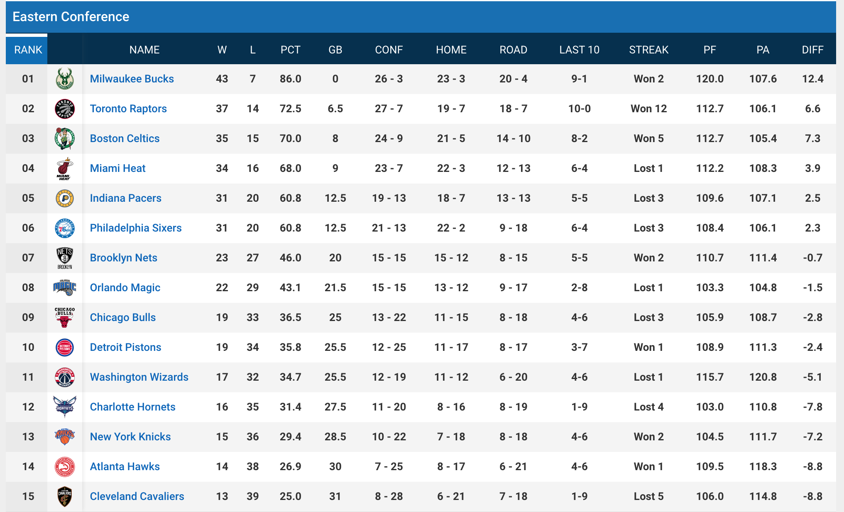
Probability: inference
Informed by empirical data
Notes:
As an example here is the current (mid-season) standing of the Eastern Conference of the NBA. In basketball there are no ties so the outcome of an individual game must be either a win or a loss.

Slide 36
Probability: inference
Informed by empirical data
Notes:
The standings are ordered such that the team with the highest win percentage is at the top and teams descend in order. These can be directly interpreted as probabilities of each team wining there next game(s). Note that we can use these without needing to understand why a team is good or bad.

Slide 37
Probability expectation: coin flips
Notes:
Let’s apply what we have learned to a classic toy example of probability – coin flips.

Slide 38
Probability expectation: coin flips
p(Heads) = 0.5
Notes:
First we will use expectation (a model with a perfect probability of 0.5 of getting heads.

Slide 39

Probability expectation: coin flips
p(Heads) = 0.5
Notes:
We will consider the result of four coin flips as the total number of heads.

Slide 40
Probability expectation: coin flips
Exercise
Notes:
DO ON BOARD (I turn slides to black with my clicker for this): Start by asking what are the possible outcomes for flipping a fair coin 4 times? (They should easily realise that the fewest heads possible is zero and most four and that all intermediate values are possible)
Then ask what are the possible sequences for each number of heads? I start with extremes, TTTT and HHHH then move to middle (six possible sequences)
What is the probability of each sequence? Then we need to know if we use OR or AND rule. Finally check that probability for each out come (0-4 Heads) sums to one.

Slide 41
Probability inference: coin flips
Exercise
Notes:
Next we will perform same experiment with 2p coin and attempt to infer the probabilities for each specific total of heads.
Get students to flip a coin 4 times and record how many heads they got – by show of hands get totals of each and plot straight away in R. Should see same central peak but generally less perfectly symmetrical.

Slide 42
Probability inference: coin flips
HHTT
HTHT
HTTT
HTTH
THHH
THTT
THHT
HTHH
TTHT
THTH
HHTH
TTTT
TTTH
TTHH
HHHT
HHHH
0
1
2
3
4
N heads
Notes:
Return to slides at this point and note that we could use heights here as a histogram plot of frequency.

Slide 43
Probability distributions
0
1
2
3
4
N heads
Notes:
Bars would look like this.

Slide 44
Probability distributions
Frequency
0
1
2
3
4
N heads
Notes:
Y-axis is frequency.

Slide 45
Probability distributions
Density
0
1
2
3
4
N heads
Notes:
But could take each bars heighta dn divide by summed height of all bars to get new axis: “density”

Slide 46
Probability distributions
p(0) + p(1) + p(2) + p(3) + p(4) = 1
Density
0
1
2
3
4
N heads
Notes:
This is the probability of each outcome and is a visual way of representing one of our probability rules – probabilities of all possible outcomes must sum to one.

Slide 47
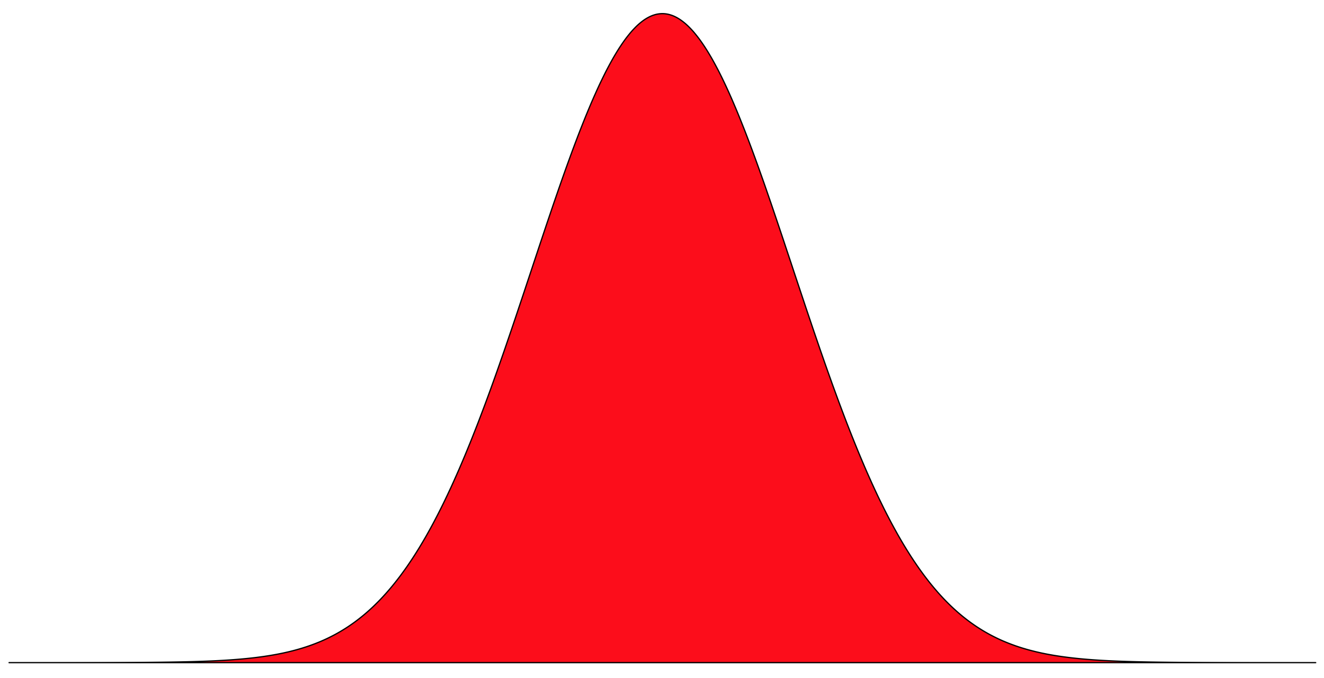
Probability distributions: features
Notes:
These diagrams are known as probability density functions and have special key features.

Slide 48
Probability distributions: features
All possible outcomes
Notes:
The x-axis should represent all possible outcomes.

Slide 49
Probability distributions: features
Area under curve = 1
All possible outcomes
Notes:
The area under the curve (or height of all the bars) must sum to 1.

Slide 50
Probability distributions: features
Shape of curve defined by an equation
(the Probability Density Function)
Area under curve = 1
All possible outcomes
Notes:
The shape of the curve should be defined by a n equation (called the probability density function) – make clear density should be clustered around high probability outcomes and lower in other pless probable cases.

Slide 51
Probability distributions: the binomial
Notes:
There are many different kinds of probability distribution and they can be employed as models to understand real world data. We have already encountered one of these – called the binomial.

Slide 52
Probability distributions: the binomial
Density
0
1
2
3
4
N heads
Notes:
Our heads example is just such a binomial – named for there being two possible outcomes.

Slide 53
Probability distributions: the binomial
Generalizable to any two outcome scenario
Density
0
1
2
3
4
N heads
Notes:
Can be generalised far beyond coin flips to any scenario where there are only two possible types of outcome (heads/tails, win/lose or generally success/failiure.)

Slide 54
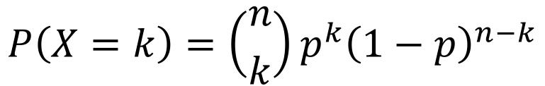
Probability distributions: the binomial
Generalizable to any two outcome scenario
Probability Density Function (PDF)
Density
$$P\left(X=k\right)=\left({n \atop k}\right)p^{k}{\left(1−p\right)}^{n−k}$$
Where k = specific outcome (e.g., 2 Heads)
n = number of trials (e.g., 4 flips)
p = probability of success (e.g., Heads)
0
1
2
3
4
N heads
Notes:
There is a simple equation that we can use in place of the work we did on the whiteboard. This gives us the probability for each specific outcome in terms of N successes (represented by k).
Explain that n over k is the binomial coefficient and does the job of estimating every possible sequence that can lead to a total of k successes.
The rest only looks more complex as it allows us todeal with scenarios where the p of success and p of failiure are different (i.e., in our coin example they were equal, simplifying things,).

Slide 55

Probability distributions: the binomial
Generalizable to any two outcome scenario
Probability Density Function (PDF)
Density
$$P\left(X=k\right)=\left({n \atop k}\right)p^{k}{\left(1−p\right)}^{n−k}$$
Where k = specific outcome (e.g., 2 Heads)
n = number of trials (e.g., 4 flips)
p = probability of success (e.g., Heads)
0
1
2
3
4
N heads
dbinom(x = k, size = n, prob = p)
Notes:
As we will see, we never really need to work through these equations manually. And R has a specific function that will generate a binomial distribution for us.
D is for density, binom is for binomial and inputs are k successes, n trials, and p of success. (0:4, 4, and 0.5 in our coin example).

Slide 56
Applying the binomial
Notes:
Of course as geologists we don’t actual care about flipping coins, but we can use the binomial as a simple model to ask questions about the probability of real outcomes.

Slide 57
Applying the binomial
Q: Are changes in the number of dinosaur species through the Mesozoic distinguishable from flipping a fair coin?
Notes:
Here we will specifically ask whether the number of dinosaur species in successive geologic stages of the Mesozoic is distinguishable from flipping a fair coin (heads, species increase, tails they decrease).

Slide 58
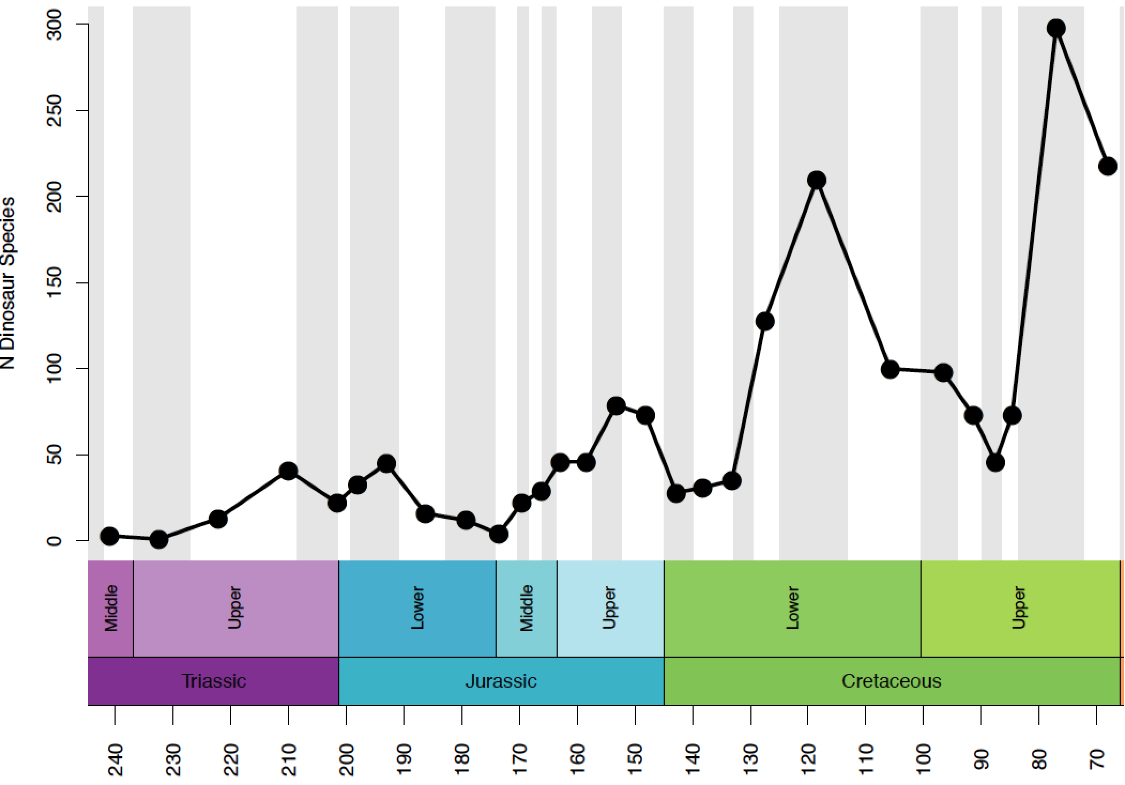
Applying the binomial
Time (Ma)
Notes:
Here is the data. Explain x-axis and note we are missing the early part of Triassic as we have no dinosaur fossils from then.

Slide 59
Applying the binomial
Time (Ma)
Notes:
We can simplify this data so it can be expressed in a binomial way (up arrow for increase, down for decrease.
Ask class if increase and decrease are only two possible outcomes. Hopefully they spot that stay the same is the other and show this does happen – once. Thus to continue we will have to ignore this issue – a common occurrence when meshing nice ideal probability distributions with the real world!

Slide 60
Applying the binomial
Notes:
Thus we have a timeline that looks like this.

Slide 61
Applying the binomial
x 12
x 14
Notes:
But we can simplify it further by simply adding the total number of each type.

Slide 62
Applying the binomial
x 12
x 14
dbinom(x = c(0:26), size = 26, prob = 0.5)
Notes:
Now we can use R to calculate our probability distribution. There are 27 possible outcome, from zero to 26 increases. With 26 total stage-to-stage transitions. Our probability is drawn from the notion of a fair coin so it is 0.5.

Slide 63
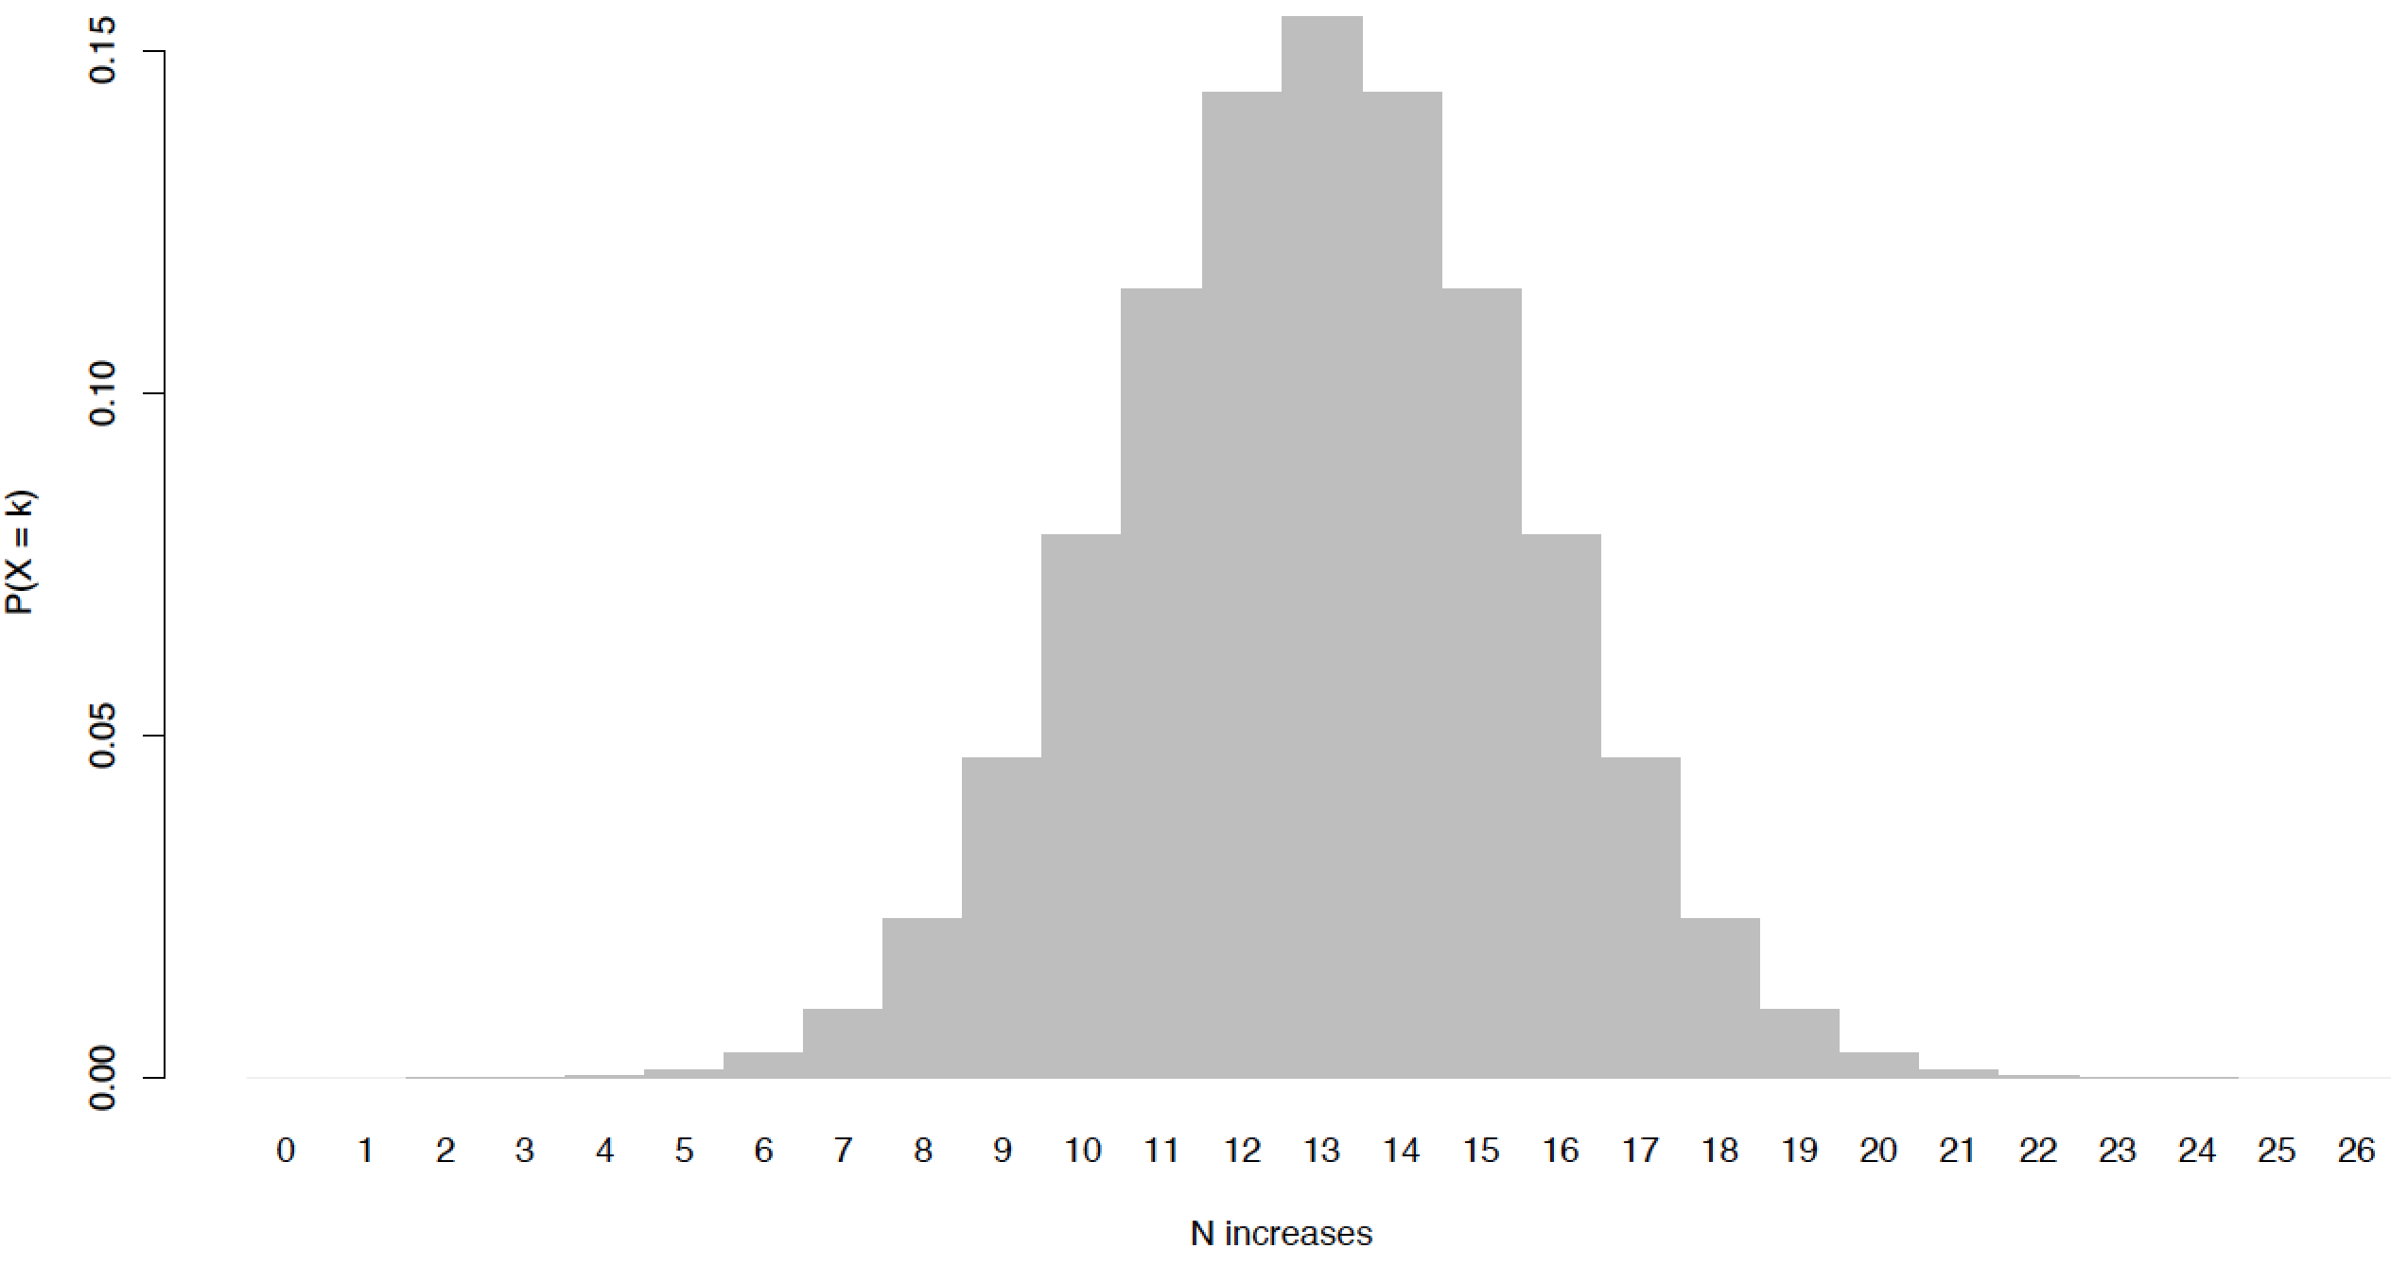
Applying the binomial
Notes:
Here is what the binomial distribution looks like. Note that it is not simply a single tower of 13 increases, although this is the most probable single outcome. This we should not be surprised by values like 12 or 14, but we can see towards the edges values like 2 or 25 are very unlikely if the coin model is correct.
We can extend this idea by breaking up the binomial into different outcomes and use these to interpret our actual value.

Slide 64
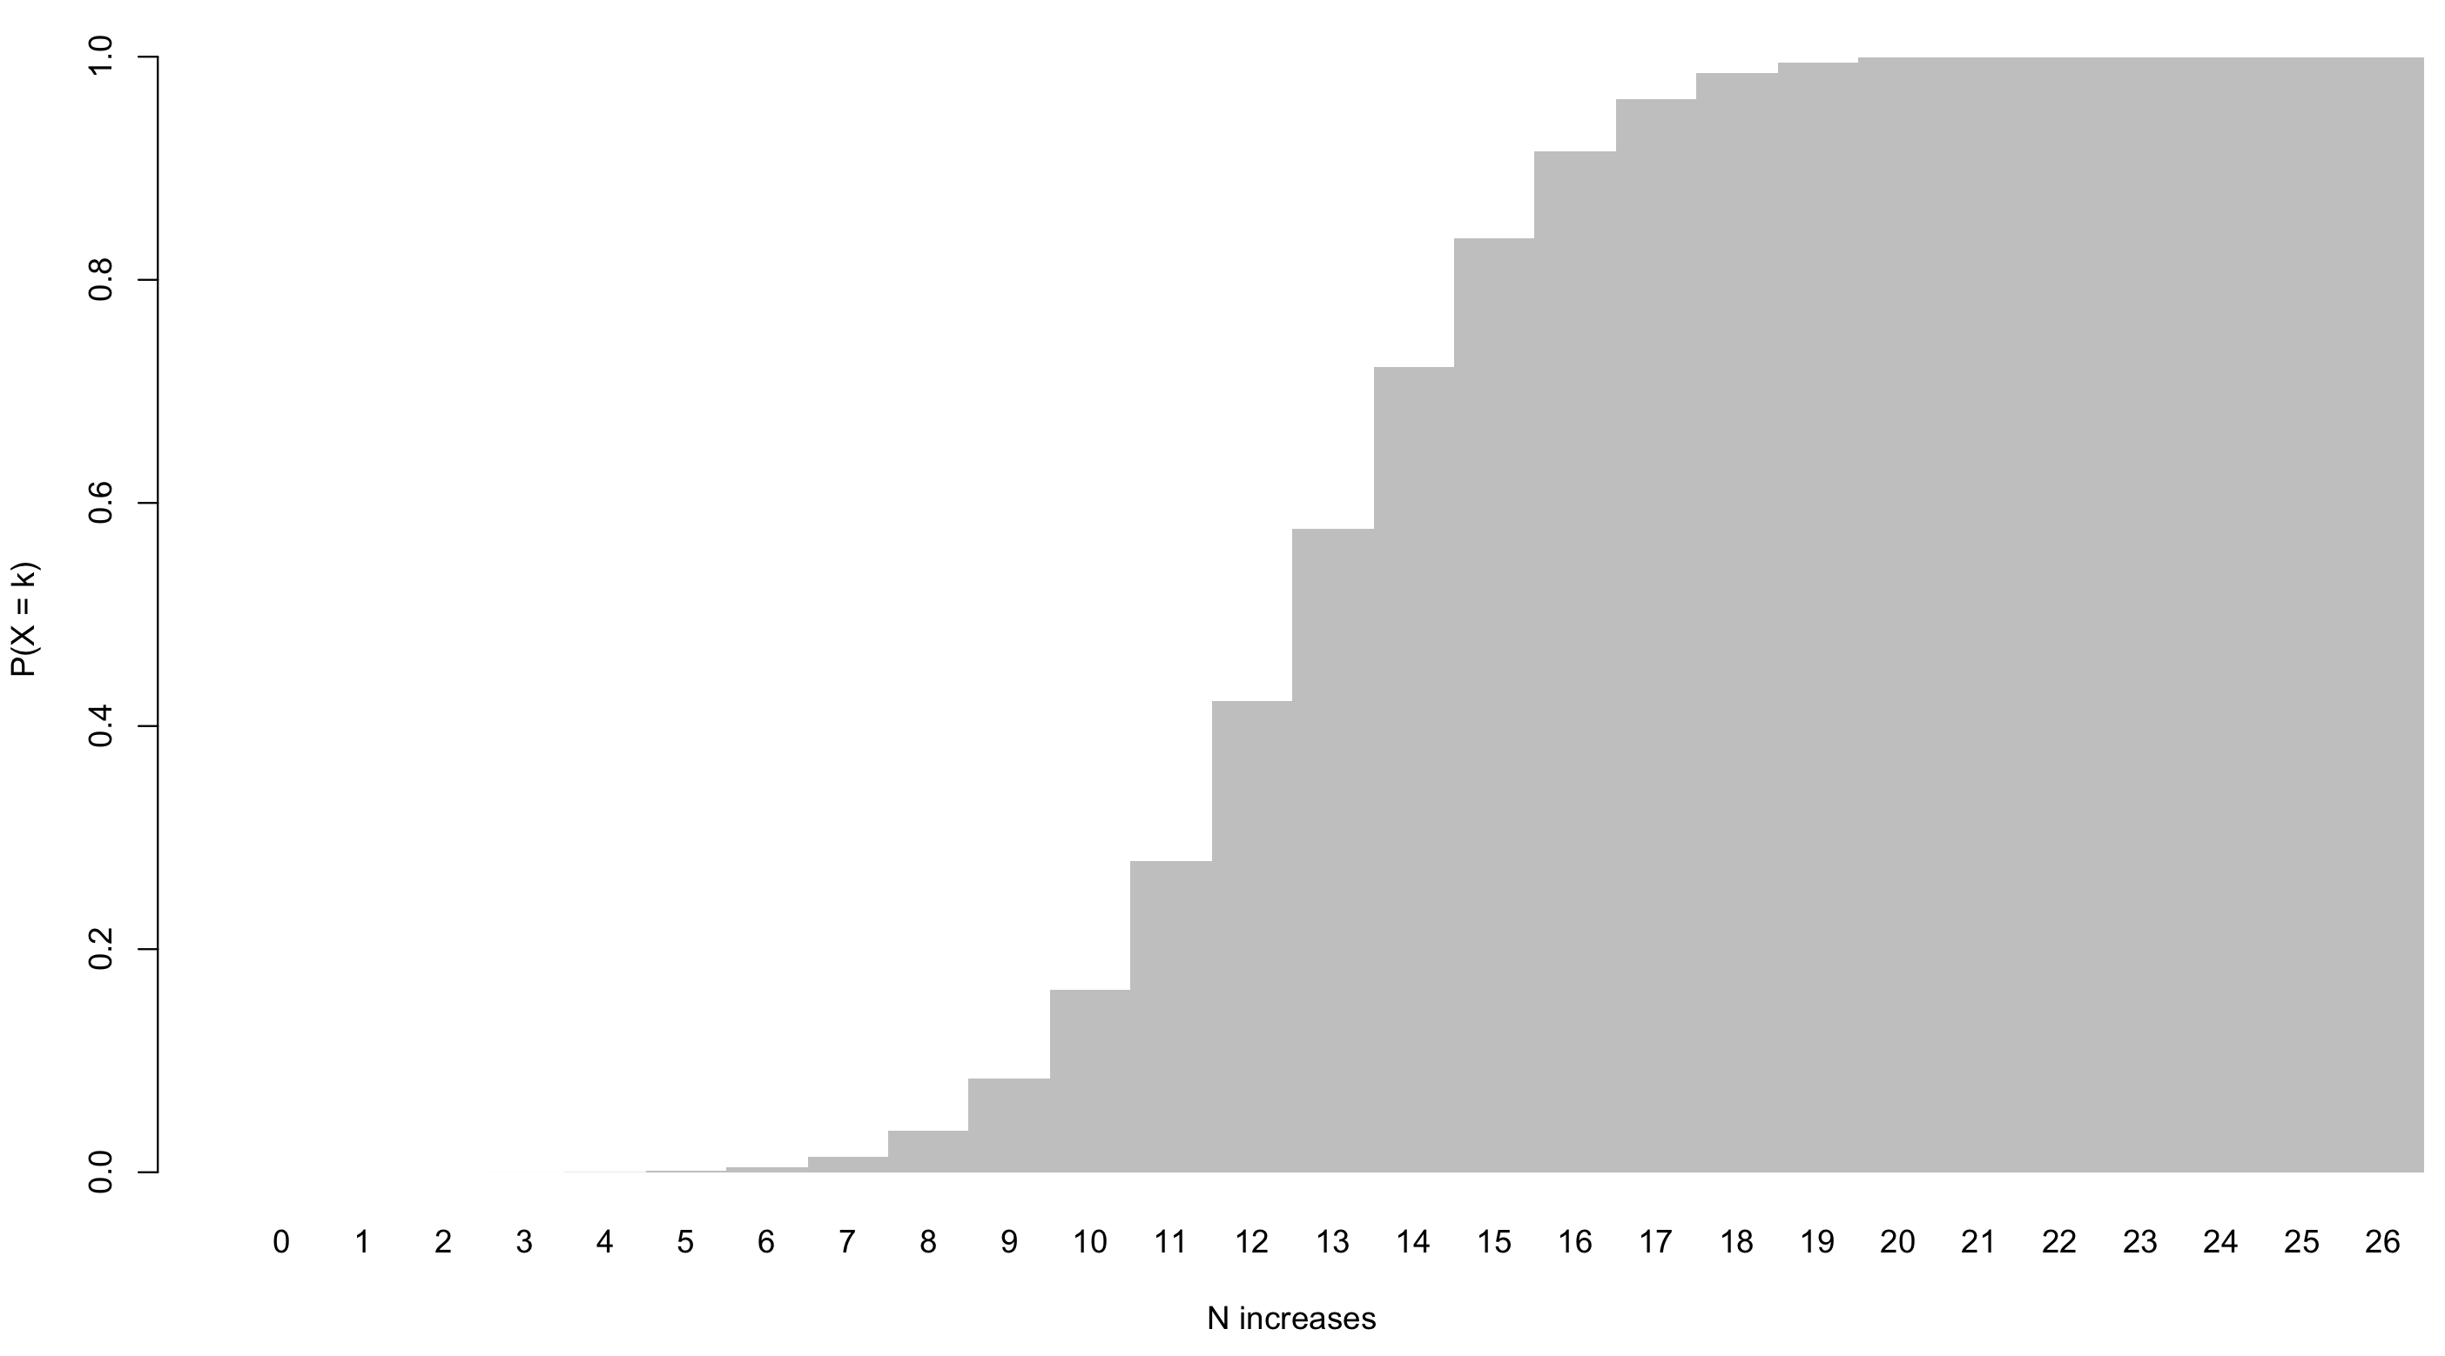
Probability distributions
Cumulative Distribution Function
Notes:
To do this we could, for example, assign the middle 50% of the data to the balanced increases-decresaes (p(increase) = 0.5 scenario, But how do we get the middle 50%, well one handy trick is to replot the data as a cumulative distribution function (one exists for each PDF). Here the height of each bar is the probability of that value plus every value to the left of it.

Slide 65
Probability distributions
Cumulative Distribution Function
Full range of probabilities
Notes:
Thus the y for a CDF will always range from 0 to 1. (Another way of showing the all-possible-outcomes-must-sum-to-one rule).

Slide 66
Probability distributions
Cumulative Distribution Function
Full range of probabilities
0.25
Notes:
To get the middle 50% we need to know two values, the lower 25% boundary – findable by reading across from y (0.25) to x (11).

Slide 67
Probability distributions
Cumulative Distribution Function
0.75
Full range of probabilities
0.25
Notes:
Then doing same for the 75% value (0.75 to 15).

Slide 68
Probability distributions
Cumulative Distribution Function
0.75
Full range of probabilities
Middle 50%
0.25
Notes:
Thus we can see the middle 50% of the density is outcomes for 11 to 15 increases.

Slide 69
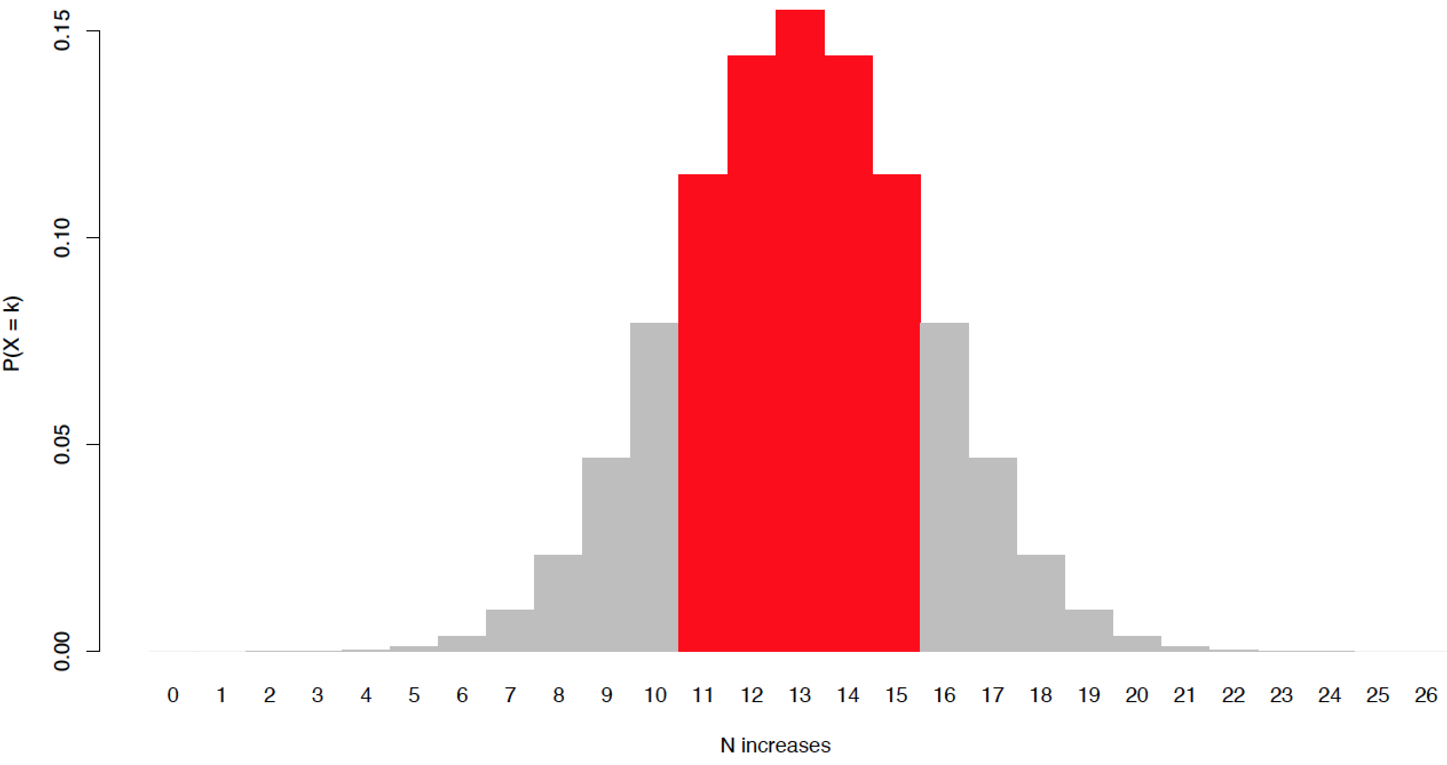
Applying the binomial
Notes:
Thus we can return to our binomial PDF and highlight the middle 50%.

Slide 70
Applying the binomial
≈
Notes:
We can attach to this the notion that increases and decreases are equal/in balance.

Slide 71
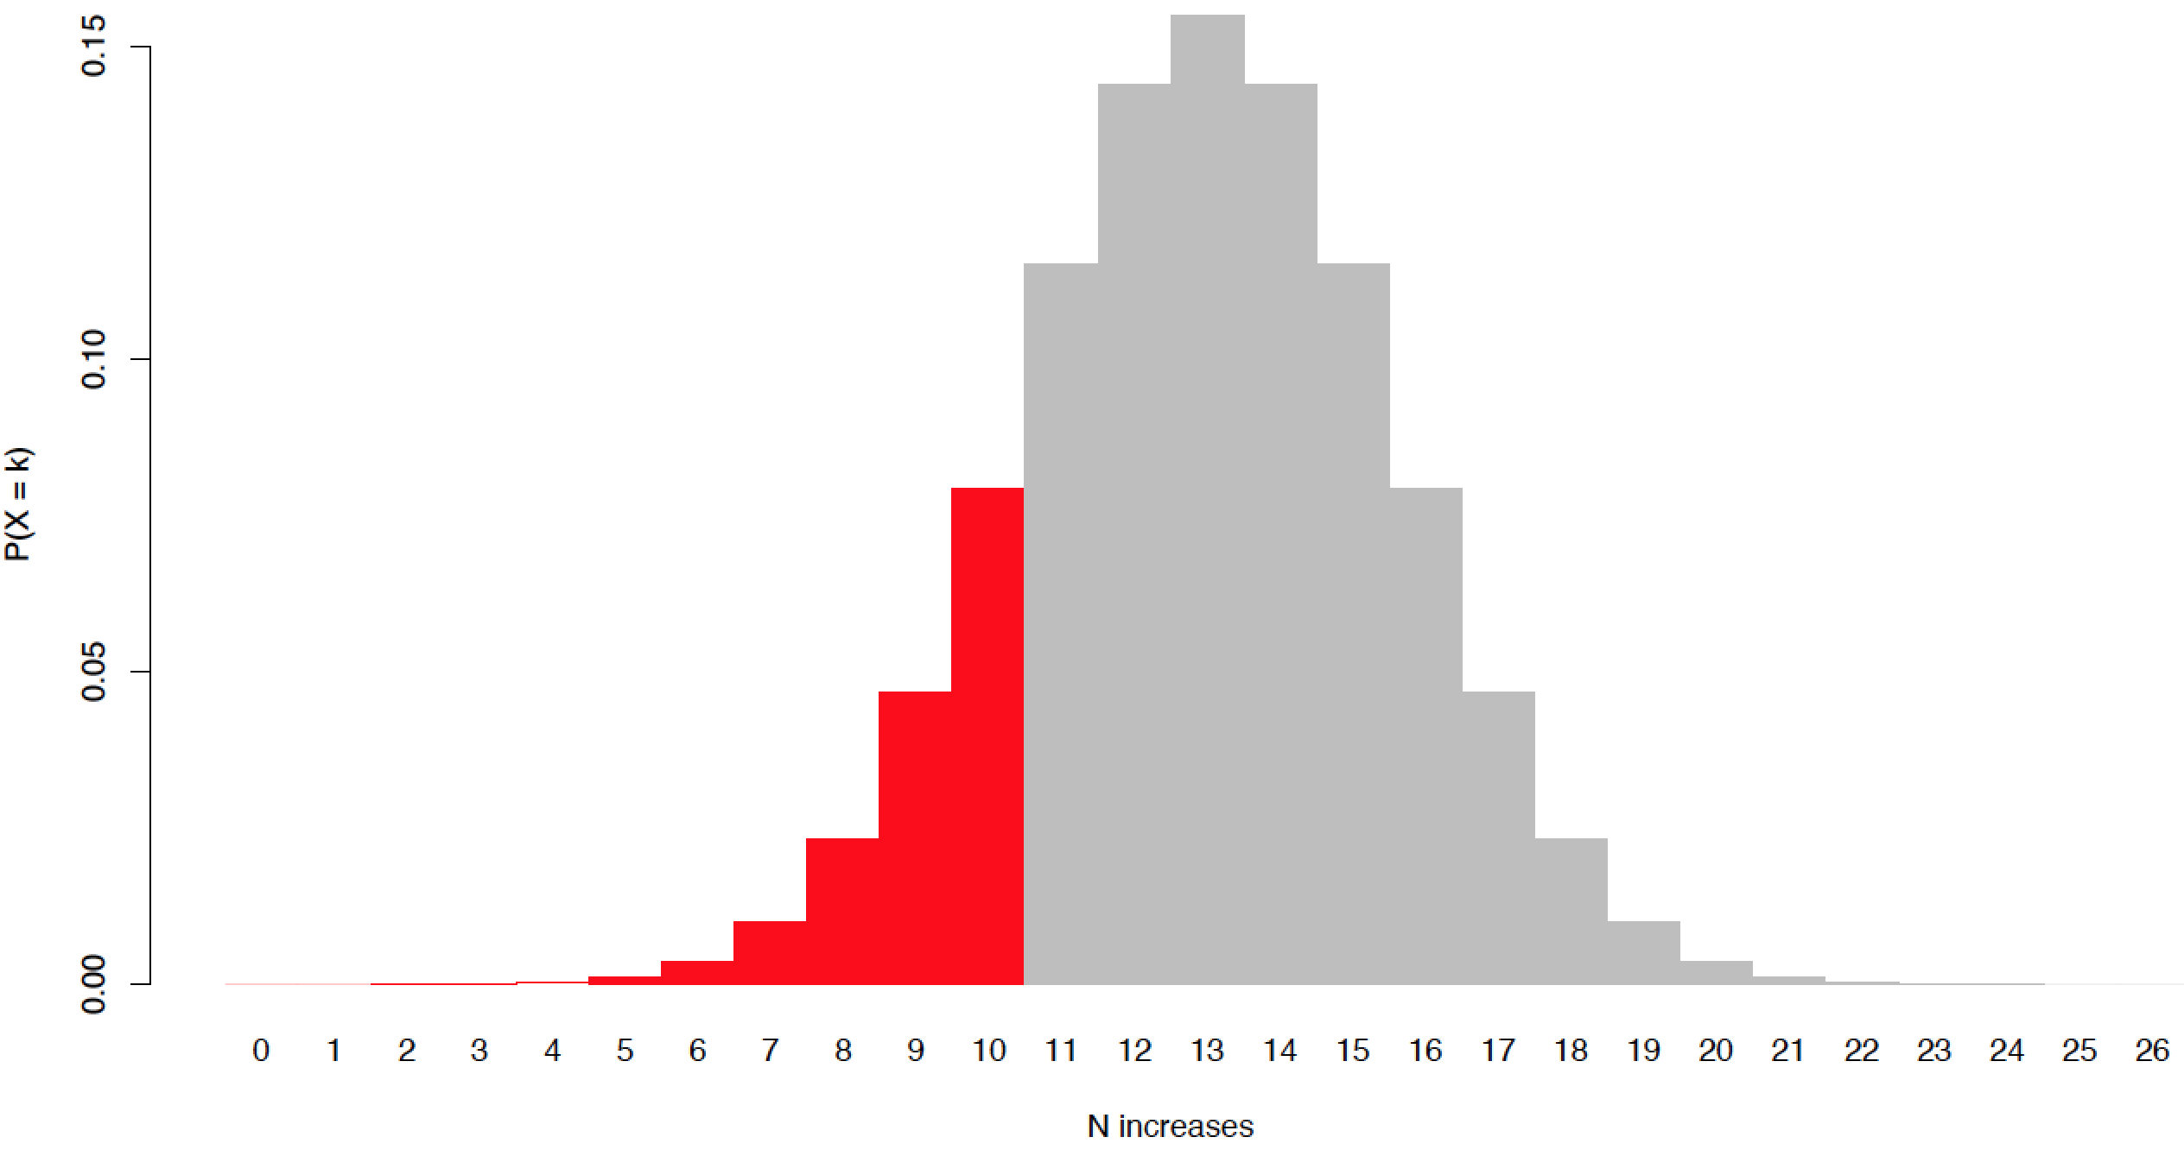
Applying the binomial
>
Notes:
This values less than this suggest a bias towards decreases.

Slide 72
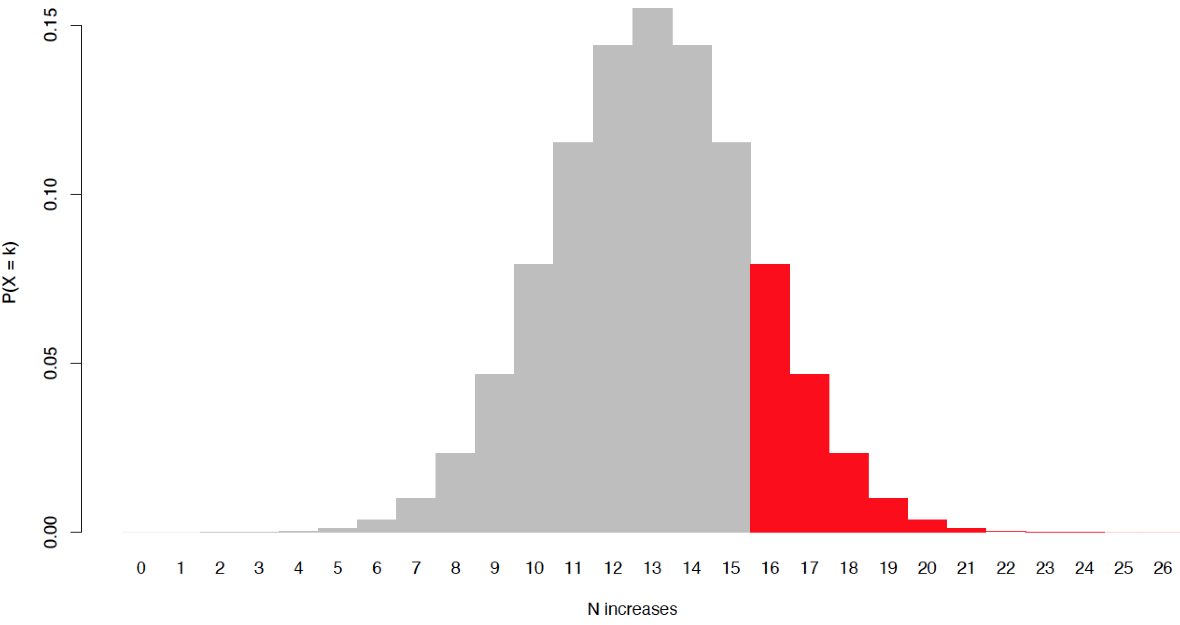
Applying the binomial
>
Notes:
And more than this a bias towards increases.

Slide 73
Applying the binomial
>
≈
>
Notes:
Thus we now have a space we can interpret our actual value in.

Slide 74
Applying the binomial
>
≈
>
Notes:
We actually found 14 increases. Inside our equal or balanced interpretation.

Slide 75
Applying the binomial
Stage-to-stage changes in the number of dinosaur species are indistinguishable from random coin flips
or
There is no clear bias towards increases (or decreases) in dinosaur species number through the Mesozoic
Notes:
Ths we can conclude that dinosaur species number increases or decreases much as though a coin was being flipped. Or more appropriately that there is no clear bias towards stage-to-stage transitions of being dominated by either increases or decreases.

Slide 76
Applying Lesson #2
Time (Ma)
Notes:
Before we leave dinosaurs let’s return to Lesson #2 and think a bit more about the data. What does random increases or decreases really mean, Did dinosaurs go extinct at any point? Was this a fluke (never a decrease whenthe number was already very low)?

Slide 77
Rolling dice: expectation

Slide 78
Rolling dice: expectation
p(1) = p(2) = p(3) = p(4) = p(5) = p(6) = 1/6

Slide 79
Rolling dice: expectation
p(1) = p(2) = p(3) = p(4) = p(5) = p(6) = 1/6
p(X = k)
1
2
3
4
5
6
k

Slide 80
Rolling dice: inference
Exercise

Slide 81
Probability distributions: the uniform

Slide 82
Probability distributions: the uniform
p(Any outcome) = p(Any other outcome)

Slide 83
Probability distributions: the uniform
p(Any outcome) = p(Any other outcome)
p(X = k)
All possible outcomes

Slide 84
Probability distributions: discrete vs continuous

Slide 85
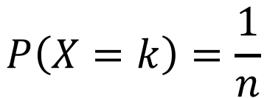
Probability distributions: discrete vs continuous
Discrete
(e.g., discrete uniform)
$$P\left(X=k\right)=\frac{1}{n}$$
p(X = k)
Limited specific outcomes

Slide 86
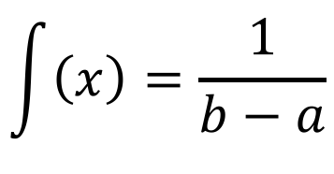
Probability distributions: discrete vs continuous
Discrete
(e.g., discrete uniform)
Continuous
(e.g., continuous uniform)
$$P\left(X=k\right)=\frac{1}{n}$$
$$\int{\left(x\right)}=\frac{1}{b−a}$$
a
b
p(X = k)
f(x)
Limited specific outcomes
All intermediates possible

Slide 87
Probability distributions: the normal

Slide 88
Probability distributions: the normal

Slide 89
Probability distributions: the normal
-∞
+∞

Slide 90
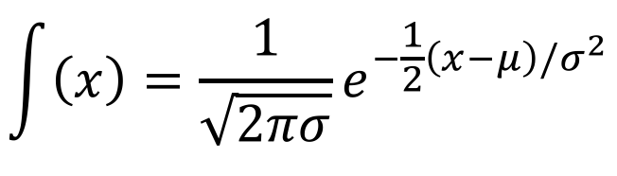
Probability distributions: the normal
Probability Density Function
$$\int{\left(x\right)}=\frac{1}{\sqrt{2πσ}}e^{−\frac{1}{2}\left(x−μ\right)/σ^{2}}$$
-∞
+∞

Slide 91
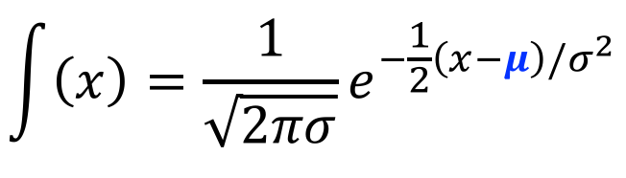
Probability distributions: the normal
Probability Density Function
μ
$$\int{\left(x\right)}=\frac{1}{\sqrt{2πσ}}e^{−\frac{1}{2}\left(x−μ\right)/σ^{2}}$$
-∞
+∞

Slide 92
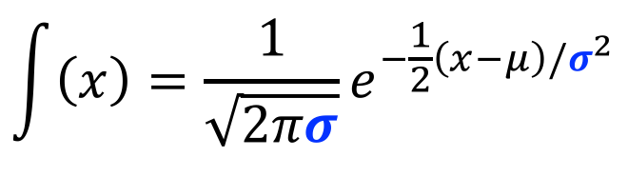
Probability distributions: the normal
Probability Density Function
$$\int{\left(x\right)}=\frac{1}{\sqrt{2πσ}}e^{−\frac{1}{2}\left(x−μ\right)/σ^{2}}$$
Middle
68.2%
-∞
-1σ
1σ
+∞

Slide 93
Probability distributions: the normal
Probability Density Function
$$\int{\left(x\right)}=\frac{1}{\sqrt{2πσ}}e^{−\frac{1}{2}\left(x−μ\right)/σ^{2}}$$
dnorm(x = x, mean = mu,
sd = sigma)
-∞
+∞

Slide 94
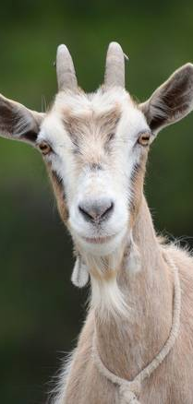
Goats!

Slide 95
Goats!
Option A
Option B
(Pick one)
(Pick one)
Stick with initial door
Switch to other door
Stick or switch, p(Win car) is same
p(Win car) = 1/3
p(Win car) = 1/2
p(Win car) = 2/3

Slide 96
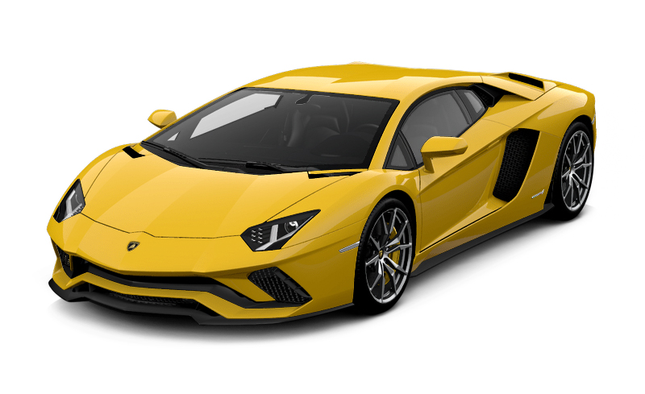
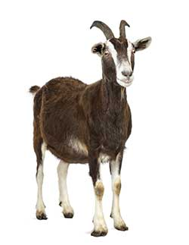
Goats!
Pick
#1
#2

Slide 97
Goats!
Pick
Shown
#1 or #2
#1
#2
#2
#1

Slide 98
Goats!
Pick
Shown
Stick
#1 or #2
#1
#2
#1
#2
#1
#2

Slide 99
Goats!
Pick
Shown
Stick
Switch
#1 or #2
#1 or #2
#1
#2
#1
#2
#1
#2

